Slide 1

Predictive Analytics on
Singapore HDB Resale Flat Prices
Presented by Forest Wang jun Lin
Cohort 47

Slide 2
Table of Content
Problem Statement
Research Objectives & Expected Deliverables
Data Understanding & Preparation
Exploratory Data Analysis (EDA)
Model Development & Evaluation
Key Insights & Feature Importance
Business Recommendations
Conclusion & Next Steps
Notes:
This presentation follows the full predictive analytics workflow. We begin with the problem statement and objectives, then explore and prepare the dataset. Next, we develop and evaluate multiple models—Linear Regression, Decision Tree, and Random Forest. Finally, we summarize key insights, business implications, and recommendations.

Slide 3
Problem Statement
Singapore’s HDB resale prices fluctuate with market trends and housing policies.
Buyers and sellers lack accurate tools to estimate fair resale prices.
Current online listings provide limited predictive insights.
Predictive analytics can improve transparency and support data-driven decision-making.
Notes:
The resale housing market in Singapore is dynamic, affected by multiple factors such as location, floor area, lease balance, and flat type. Many households rely on general listings or past transaction averages, which can be misleading. The purpose of this project is to develop a predictive model that estimates resale flat prices using key historical and structural variables. This supports both homeowners and policymakers in understanding pricing trends and fair value assessments.

Slide 4
Research Objectives
To analyze how key housing attributes (flat type, floor area, lease, town) affect resale flat prices.
To identify patterns and trends in price movements across time and locations.
To develop predictive models that accurately estimate resale prices.
To compare the performance of different algorithms (Linear, Decision Tree, Random Forest).
To generate actionable insights supporting fair valuation and housing policy decisions.
Notes:
The objectives focus on uncovering how various housing and location features influence HDB resale prices. We aim not only to predict prices but also to explain why certain factors matter more. Comparing model performance helps determine which approach yields the most reliable forecast for future use.

Slide 5
Expected Deliverables
A fully cleaned and standardized HDB resale dataset (2000–2024).
A trained and validated price prediction model.
Comparative performance report (R², RMSE) across multiple algorithms.
Visual dashboards highlighting key pricing drivers and feature importance.
Business-oriented recommendations for market forecasting and decision support.
Notes:
By the end of the project, the outcome includes a reliable predictive model, supporting visual analytics, and a clear interpretation of which variables drive price differences. The deliverables combine both technical results and business insights to help decision-makers apply the findings effectively.

Slide 6
Methodology
A Data Collection – Gathered four official HDB resale datasets (2000–2024) from data.gov.sg.
Data Cleaning & Preparation – Standardized formats, handled missing values, and created derived variables (flat age, remaining lease).
Exploratory Data Analysis (EDA) – Identified trends, correlations, and outliers influencing resale price.
Model Development – Built and compared multiple algorithms (Linear Regression, Decision Tree, Random Forest).
Model Evaluation – Measured performance using R² and RMSE to identify the best model.
Visualization & Interpretation – Visualized model results and extracted actionable insights
Notes:
The project follows a structured predictive analytics process. After collecting raw HDB data, I cleaned and standardized the dataset to ensure quality. Exploratory analysis helped uncover relationships between key features and resale prices. Then, I trained several models—Linear Regression, Decision Tree, and Random Forest—and evaluated them using performance metrics. Finally, I visualized the results to draw meaningful business insights for stakeholders.

Slide 7
Data Understanding & Preparation
Data Cleaning & Standardization
Unified column names and data formats (across all CSVs)
Converted month and lease_commence_date to datetime
Removed duplicates and corrected inconsistent entries
Feature Engineering
Calculated flat_age = year – lease_commence_date
Derived remaining_lease = 99 – (flat_age)
Categorized flat type and model as categorical variables
Notes:
This step ensured data integrity before analysis. We combined four datasets spanning more than 20 years of HDB resale transactions. Cleaning focused on standardizing date formats, fixing missing lease values, and removing duplicates. Feature engineering added derived variables like flat age and remaining lease, which are key predictors of price. After these steps, the dataset was ready for exploratory analysis and model training.

Slide 8
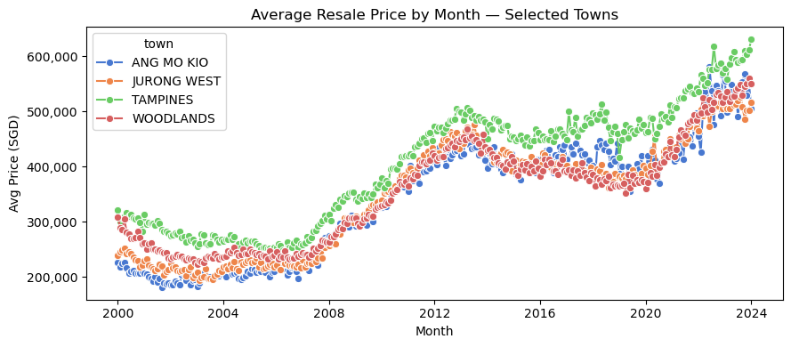
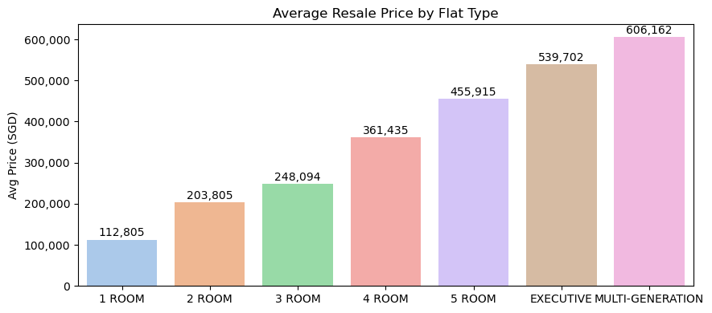
EDA-1: Trends & Mix
Prices show clear trend over years; cyclical dips/rebounds visible.
Flat type mix materially changes price levels.
Implication: include time and flat type in model features.
Notes:
Prices show clear trend over years; cyclical dips/rebounds visible.
Flat type mix materially changes price levels.
Implication: include time and flat type in model features.

Slide 9
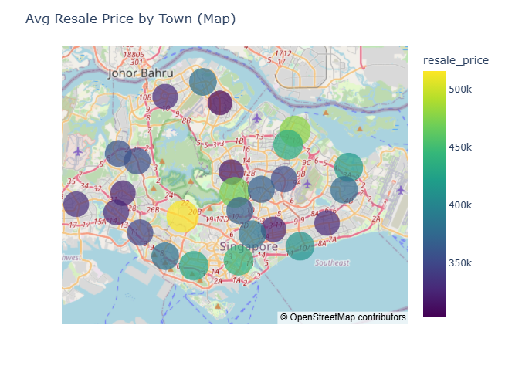
EDA-2: Geography (map)
Clear spatial gradient: central/mature towns price higher.
Outliers visible; suggests town must be encoded.
Action: add town dummies; consider region × lease interaction.
Notes:
“Prices cluster geographically; central and mature estates command a premium.
This confirms location as a primary driver; we’ll one-hot encode town and test interactions with remaining lease.
The spatial pattern supports downstream targeting (pricing guidance and buyer education).”

Slide 10
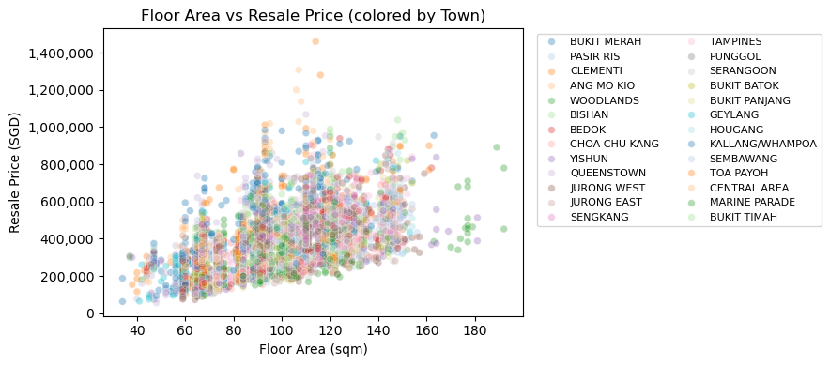
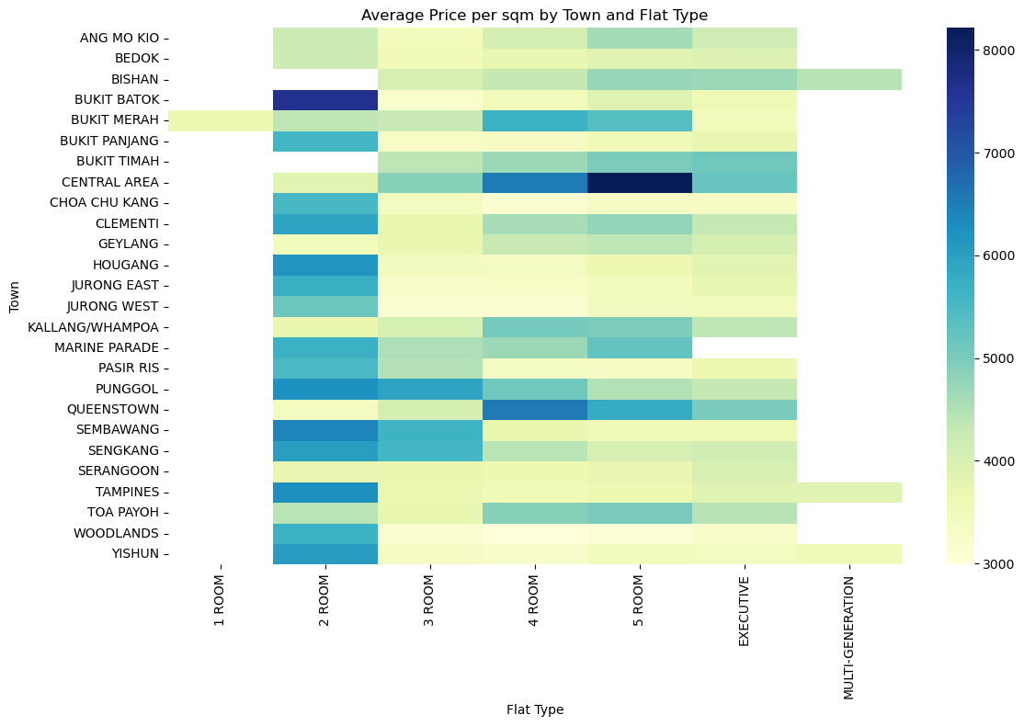
EDA-3: Drivers (Scatter + Heatmap)
Area is positively correlated with price; variance rises with size.
Price per sqm varies by town × flat type → structural premiums.
Implication: include floor area, flat type, town; use price_per_sqm for diagnostics only.
Notes:
“Scatter confirms size drives price but with wider spread at larger units—expect non-linear effects; tree-based models can capture this.
Heatmap shows systematic premiums/discounts by town and flat type; we keep both as categorical features (one-hot).
These findings finalize our feature list for modeling and justify interactions if needed.”

Slide 11
Model Development & Evaluation
Area is positively correlated with price; variance rises with size.
Price per sqm varies by town × flat type → structural premiums.
Implication: include floor area, flat type, town; use price_per_sqm for diagnostics only.
Notes:
“Scatter confirms size drives price but with wider spread at larger units—expect non-linear effects; tree-based models can capture this.
Heatmap shows systematic premiums/discounts by town and flat type; we keep both as categorical features (one-hot).
These findings finalize our feature list for modeling and justify interactions if needed.”

Slide 12
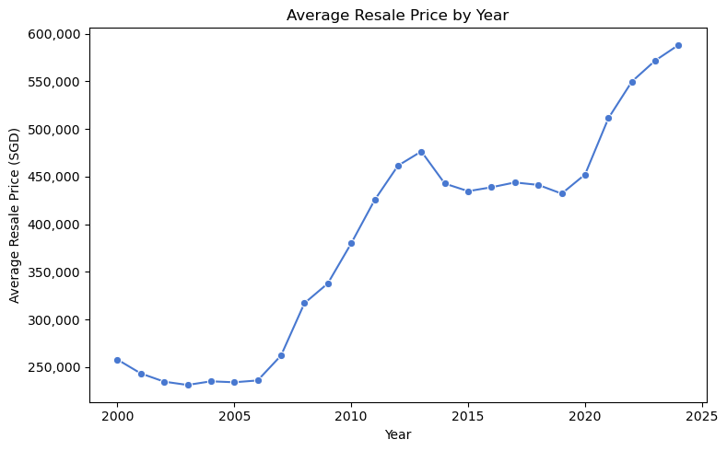
Price Trend Over Time (Yearly Average)
2009–2013: strong uptrend; prices accelerate.
2014–2019: setback/plateau with mild decline.
2020–2024: sharp rebound and new highs.
Implication: include year (and regime flags) to capture structural shifts.
Notes:
“The series shows three regimes: a run-up to 2013, a cooling phase 2014–2019, then a sharp post-2020 surge.
The mid-decade dip aligns more with policy cooling measures and supply effects; prices actually rose after 2020 despite COVID, helped by low rates, WFH demand, and supply constraints.
We encode time and a post-2019 dummy so models can learn these regime changes rather than a single linear slope.”

Slide 13
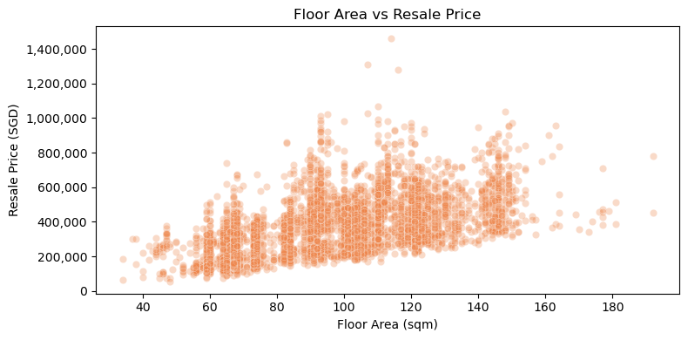
Floor Area vs Resale Price (Scatter)
Positive size–price gradient; larger units sell higher.
Diminishing returns beyond mid-sizes; slope flattens.
Heteroscedasticity: variance widens at larger areas.
Action: include floor_area; test log(price) and/or non-linear terms (tree/interaction).
Notes:
“Area is a primary driver of price, but returns taper at higher sizes—suggesting non-linearity.
The spread widens for large units, so we expect unequal error variance; logging the target or using tree-based models can stabilize fit.
We’ll keep floor_area as a core feature and allow models to learn non-linear effects and town interactions.”

Slide 14
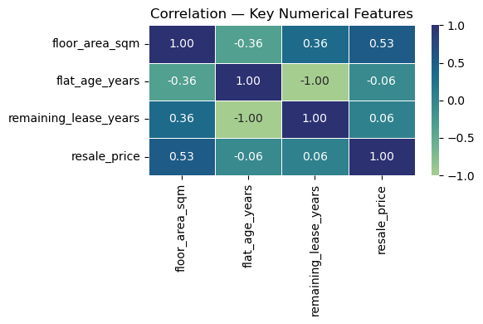
Correlation Heatmap (Drivers & Collinearity)
Price correlates with floor area and remaining lease (|r|: medium–high).
Flat age / remaining lease show opposite signs (avoid double-counting).
price_per_sqm inversely related to area (diagnostic → not a feature).
Action: keep area & lease; drop/avoid redundant pairs; proceed to VIF check.
Notes:
“Heatmap confirms area and lease as key numeric drivers of price.
We avoid leakage/duplication by not using both flat_age and remaining_lease_years together if they’re perfectly collinear, and we treat price_per_sqm as diagnostic only.
This sets up clean features for modeling; we’ll one-hot encode categoricals and run a VIF screen for the linear model before training.”

Slide 15
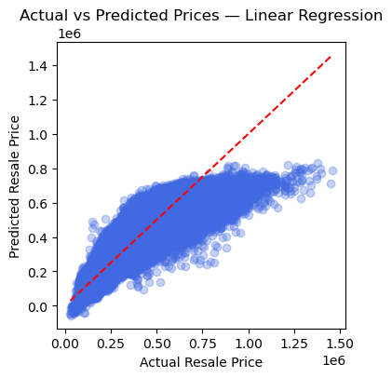
Model development - Linear Regression
Using factors (area, town, flat type, lease, year) to estimate price.
How good: explains about <R² as 73.75%> of price movements; typical miss is ~<RMSE in 83,858.53SGD> per flat.
Overall, this simple approach explains about 73.75% of price movement with a typical error of ~RMSE SGD 83,858.53 per flat.
Notes:
“Each dot compares a predicted price to the actual sale price.
Dots close to the diagonal mean we’re on target; when dots are far, the model is off.
It performs well for typical flats, but has larger misses for very big units or unusual listings.
We keep this as our baseline—clear and easy to justify—then move to models that handle complex patterns better.”

Slide 16
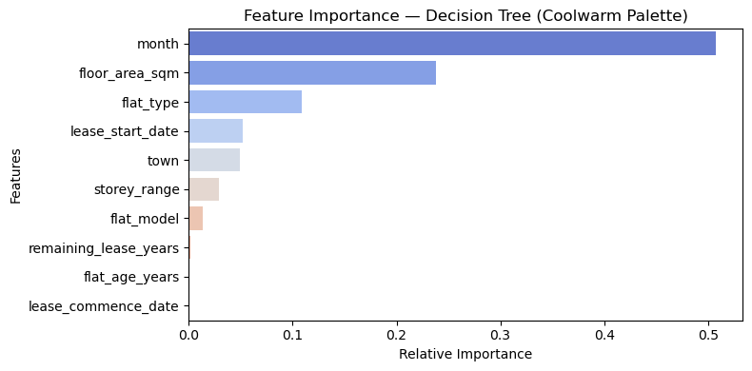
Model development - Decision Tree
What it does: splits data into simple rules (e.g., by town, area, lease) to estimate price.
How good: explains about (R² as 87.93%) of price movement; typical miss ~(RMSE in SGD56,853.22).
Notes:
it explains about 87.93% with a typical error of SGD56,853.22 per flat.

Slide 17
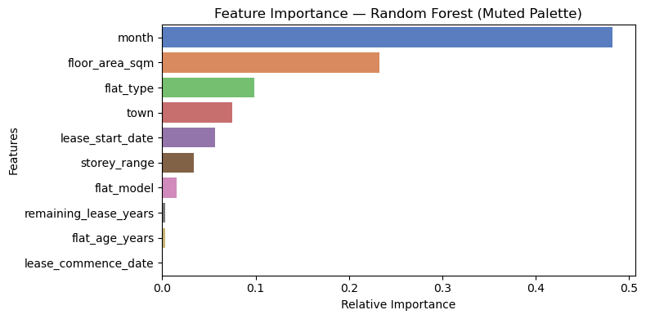
Model development - Random Forest
What it does: combines many decision trees to average out noise and improve accuracy.
How good: explains about <R² as 94.36%> of price movement; typical miss ~<RMSE in SGD 38,860.97> (best so far).
It delivers our best accuracy so far: about <R²94.36%> explained with a typical error near ~<RMSE SGD38,860.97> per flat.
Notes:
What it does: combines many decision trees to average out noise and improve accuracy.
How good: explains about <R² as 94.36%> of price movement; typical miss ~<RMSE in SGD 38,860.97> (best so far).
It delivers our best accuracy so far: about <R²94.36%> explained with a typical error near ~<RMSE SGD38,860.97> per flat.

Slide 18
Model Evaluation
Accuracy: Random Forest delivers the highest R² and lowest error.
Consistency: Cross-validation spread is tightest for Random Forest → better generalization.
Baseline role: Linear Regression is transparent; good benchmark but lower accuracy.
Stability: Single Decision Tree is less stable; risks over-fitting edge cases.
Recommendation: Use Random Forest for production; keep Linear as explainable fallback.
 | Model | R² Score | RMSE
0 | Linear Regression | 0.737510 | 83858.526719
1 | Decision Tree | 0.879350 | 56853.222920
2 | Random Forest | 0.943630 | 38860.968179
Notes:
“This chart compares how well each model tracks actual sale prices.
The Random Forest is most accurate and most consistent across folds, meaning it should hold up better on new listings.
Linear Regression remains useful as a clear, explainable baseline, but it misses some complex patterns.
A single Decision Tree forms simple rules but can latch onto quirks.
We’ll proceed with Random Forest as the main predictor and retain Linear for quick checks and auditability.”

Slide 19
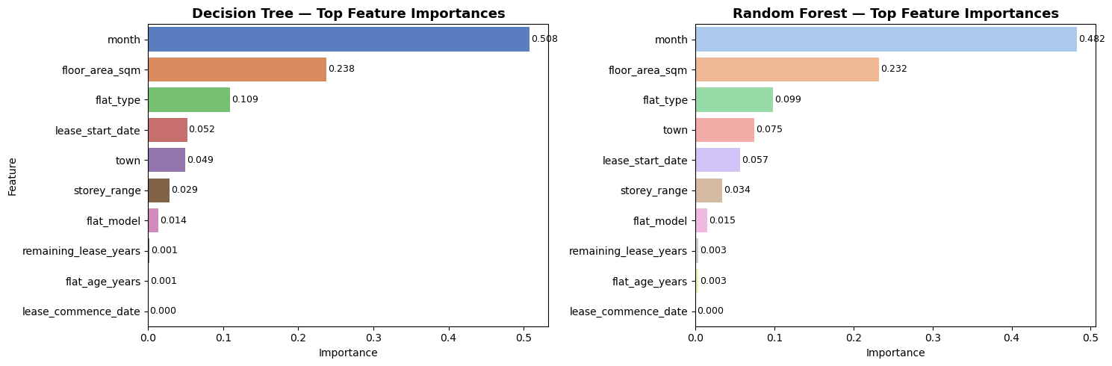
Key Insights & Feature Importance
Time signal dominates: Month is the #1 driver in both models → market cycle/price regime matters most.
Size matters: Floor area is the next strongest driver across models.
Configuration lifts value: Flat type adds a clear premium/discount.
Contextual adjusters: Town, lease start date, storey range fine-tune pricing.
Low impact: Remaining lease / flat age contribute marginally in current data.
Notes:
“Both models agree that timing is crucial—prices move with the market cycle, so month captures where we are in that cycle.
Floor area is the next lever: larger homes command higher prices.
Flat type explains layout/segment effects; town, lease start date, and storey refine the estimate.
Age/remaining lease are weaker signals here, so our pricing tool should highlight month and area first, then show configuration and location as adjustments.
We’ll retrain regularly so the time signal stays current and we don’t over-rely on past cycles.”

Slide 20
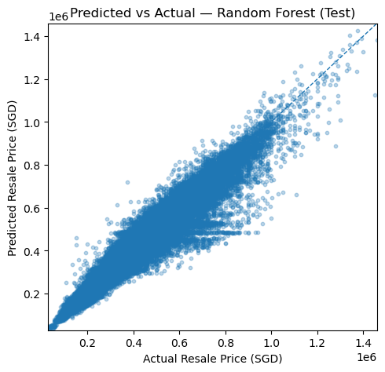
Business Recommendations
Using random Forest model to predict the price, the diagram show the variance between predicted price and actual price
“Operationalize the model in a simple tool for agents/planners.
Use plain-language drivers (area, lease, town) with each estimate.
Monitor town-level pressure to inform supply and policy decisions.”
Notes:
Using random Forest model to predict the price
“Operationalize the model in a simple tool for agents/planners.
Use plain-language drivers (area, lease, town) with each estimate.
Monitor town-level pressure to inform supply and policy decisions.”

Slide 21
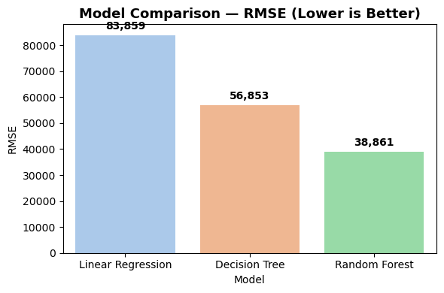
Conclusion
Result: Predictive system with best-in-class accuracy (Random Forest).
Value: Transparent, data-driven pricing for buyers & policymakers.
Next steps: 1) Deploy web app 2) Retrain quarterly 3) Add macro inputs (rates, supply) 4) Monitor drift & alert.
roadmap:
Build → Deploy → Monitor → Improve.
Notes:
an accurate, explainable predictor ready for deployment.

